Slide 1
Risk analysis of SPY and sector ETFs in machine learning
Literature Review
Advisor: Khaldoun khashanah
PREPARED BY
Tan Tu Siyuan Liu
Zihao Gao

Slide 2
The outline of our project.
Get the data
Calculate the simple return
Use 50,100,500 days to calculate the rolling window
Use historical simulation method to calculate the VaR
Use Gram-Chailer distribution to calculate the VaR, and compare to the historical method
Use machine learning to predict the VaR
Find the news cause the VaR of every ETFs has a big move of each day

Slide 3
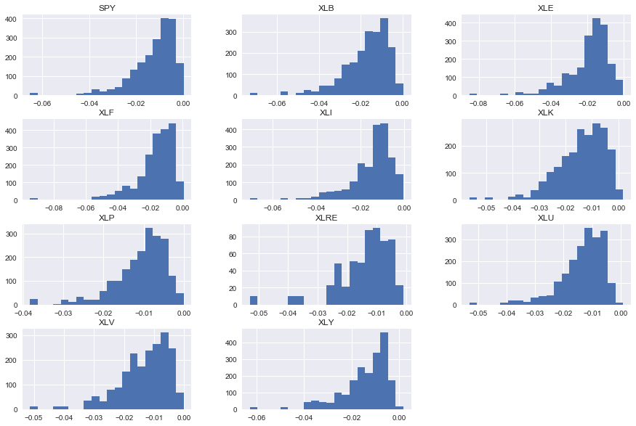
Rolling VaR with window 10 Days

Slide 4
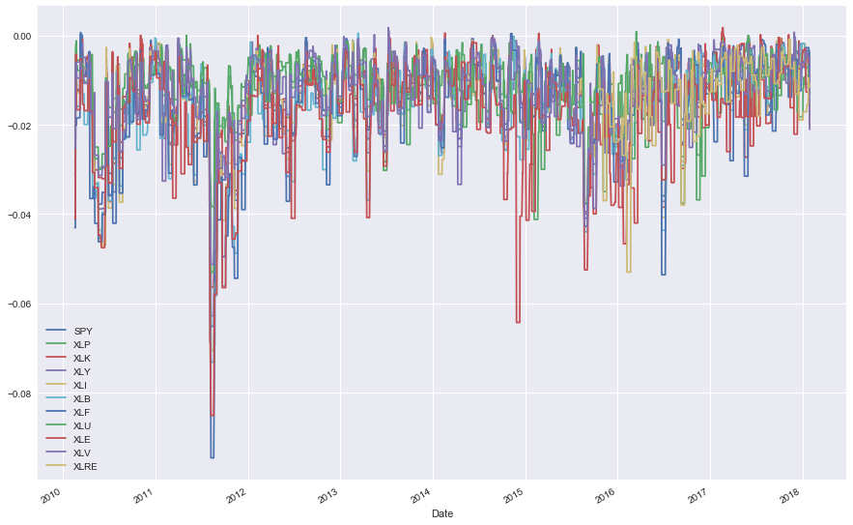
Rolling Var with window 10 Days

Slide 5
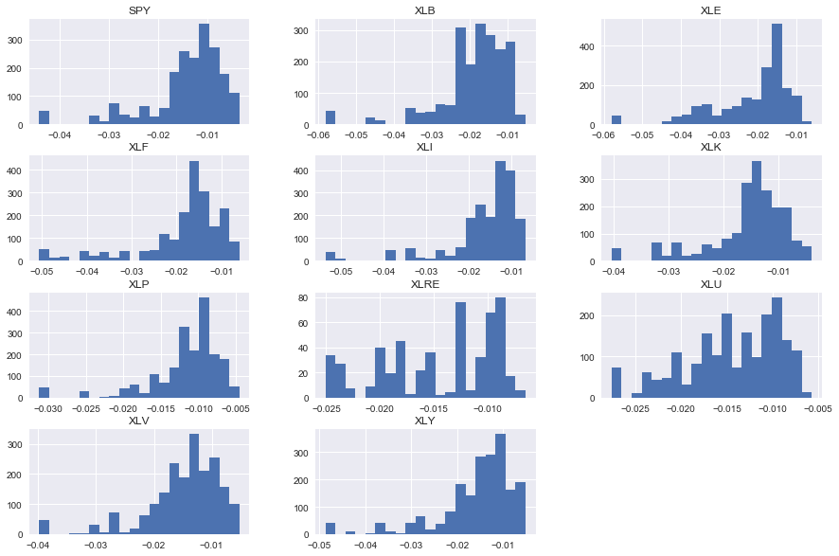
Rolling VaR with window 50 Days

Slide 6
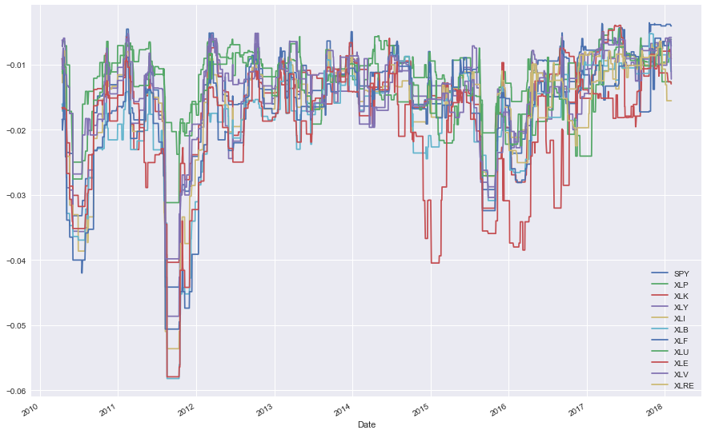
Rolling Var with window 50 Days

Slide 7
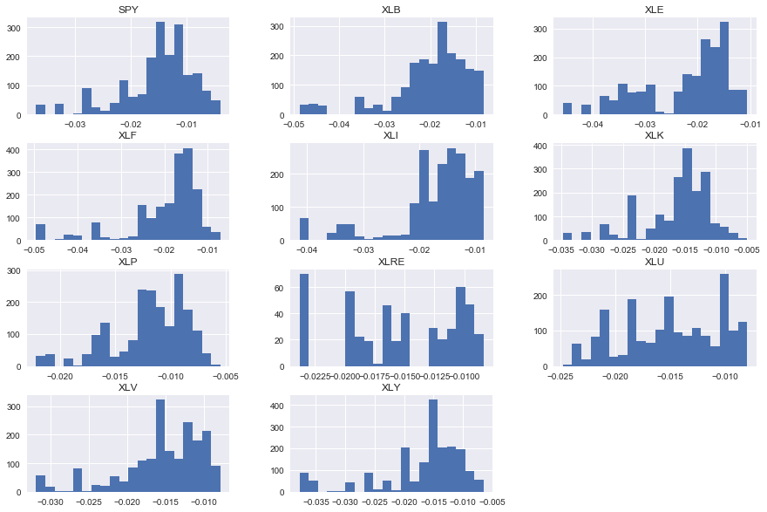
Rolling VaR with window 100 Days

Slide 8
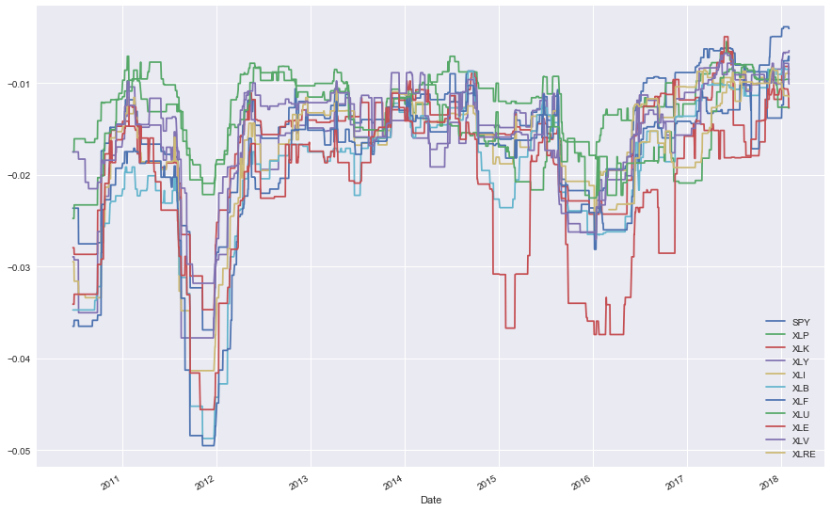
Rolling Var with window 100 Days

Slide 9
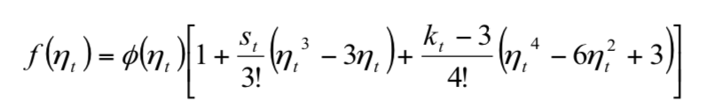
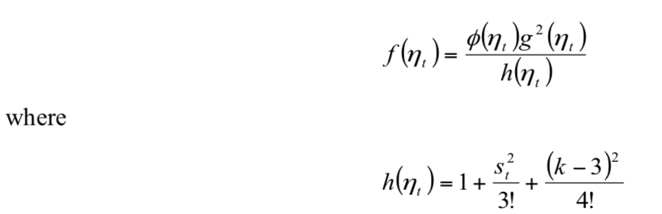
Next step
Gram-Charlier Distribution:
Galland and Tauchen(1989):

Slide 10
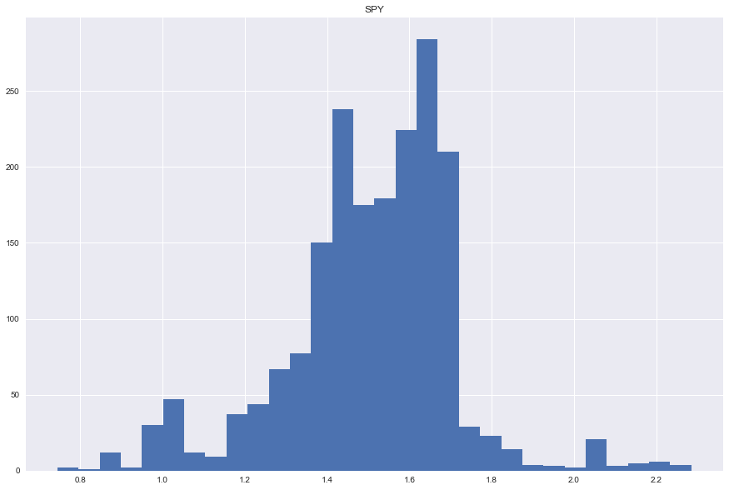
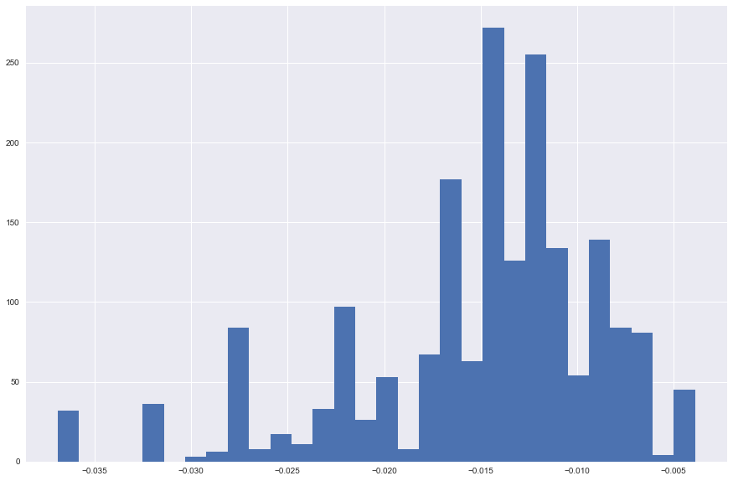
Gram-Charlier SPY 100Day VaR vs Empirical VaR

Slide 11
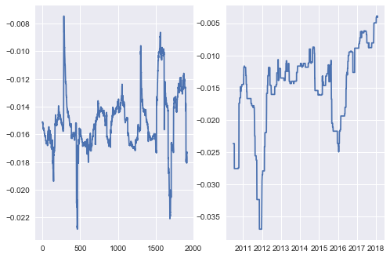
Gram-Charlier SPY 100Day VaR vs Empirical VaR

Slide 12
Thank you

